Slide 1
Blueprint samples genomic features

Slide 2
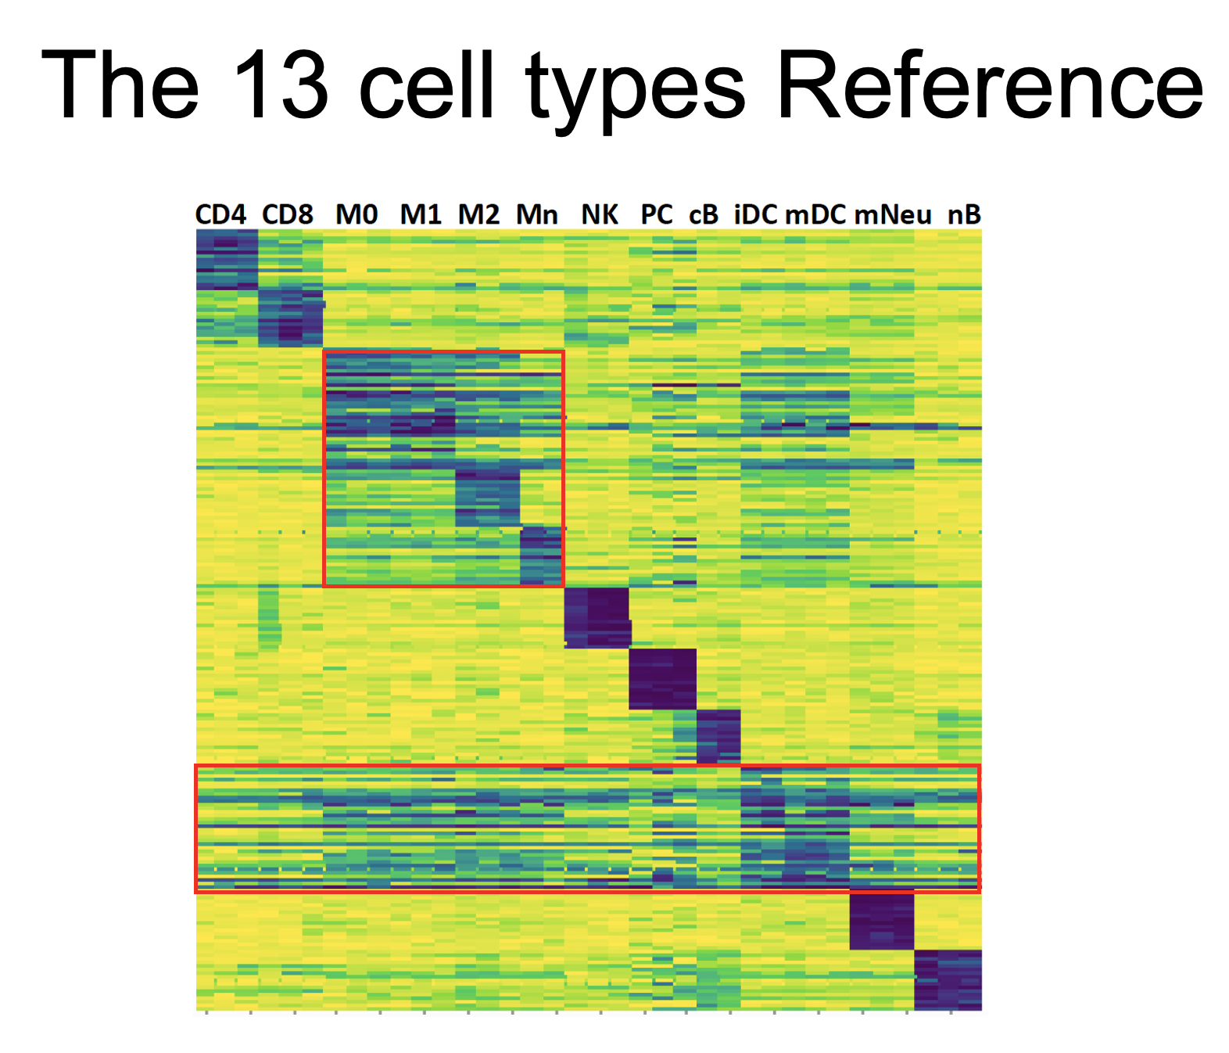
Overview
Here, we examine the Blueprint data for the markers’ methylation status.
From slide 3 to 27 the promoter regions of almost all the markers are shown for 13 cell type reference
From slide 28 the regions overlapping with the markers are reported

Slide 3
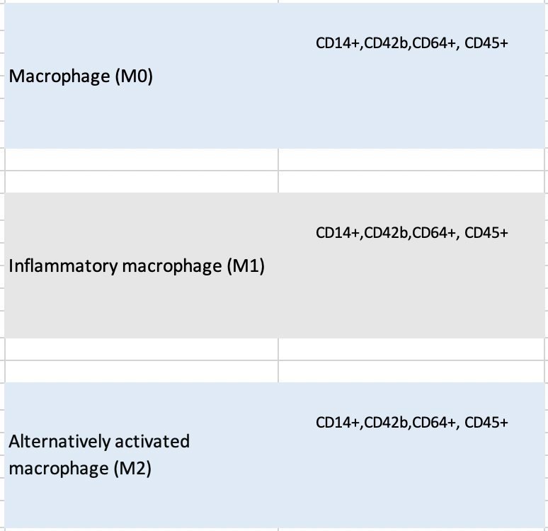
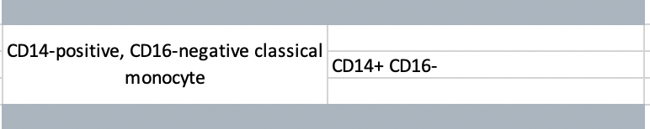
Mono, M0,M1, M2

Slide 4
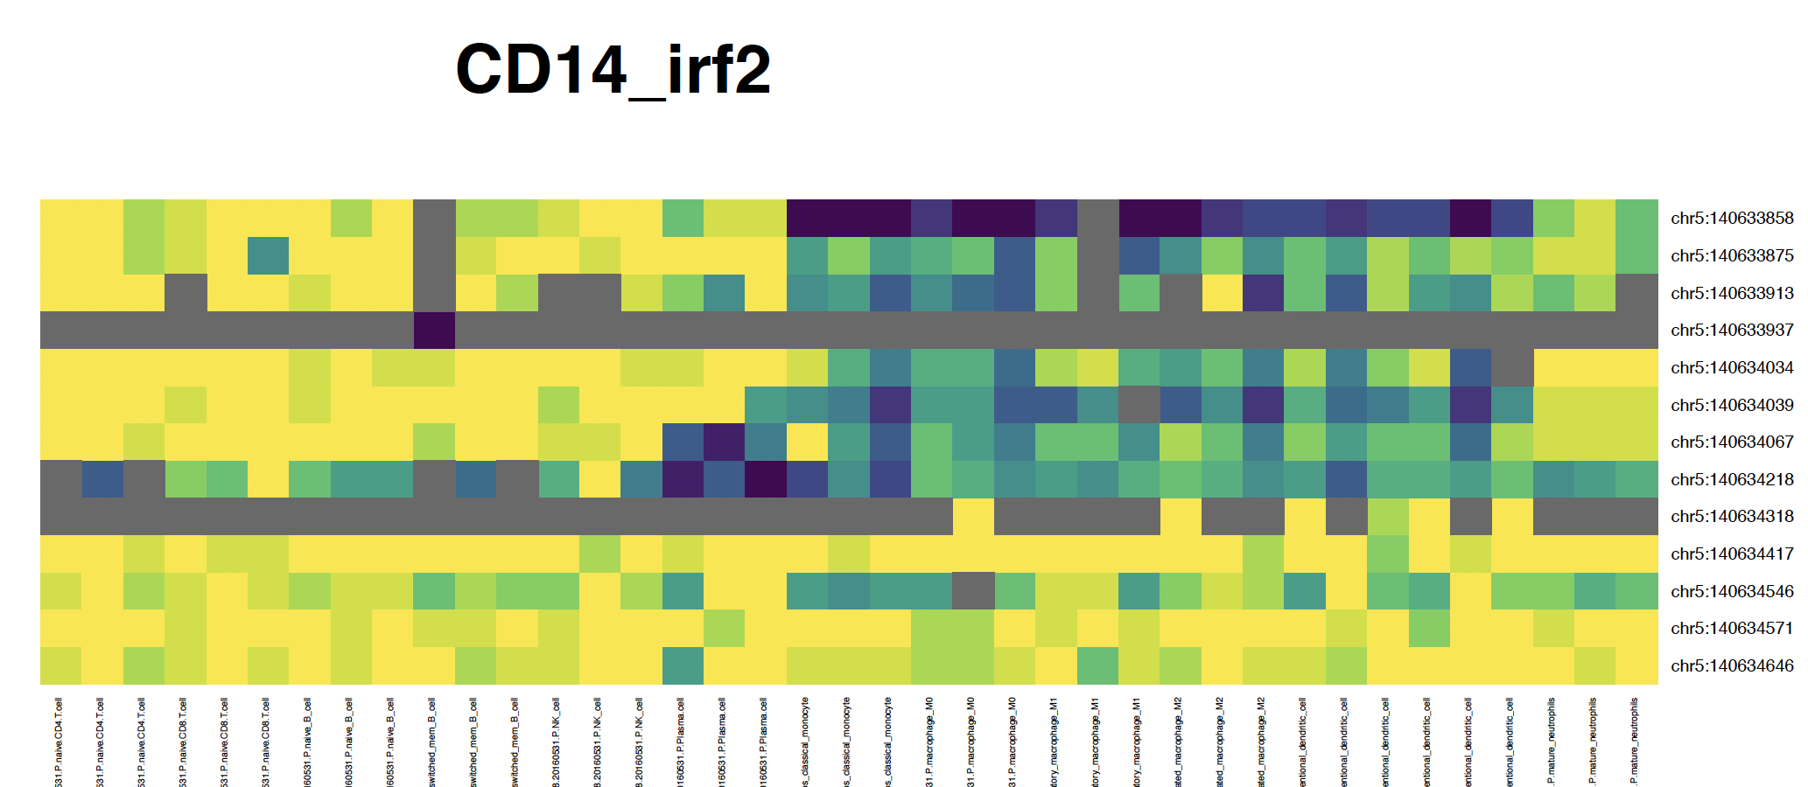
CD14 promoter
CD4
CD8
nB
cB
NK
PC
Mn
M0
M1
M2
iDC
mDC
mNeu

Slide 5
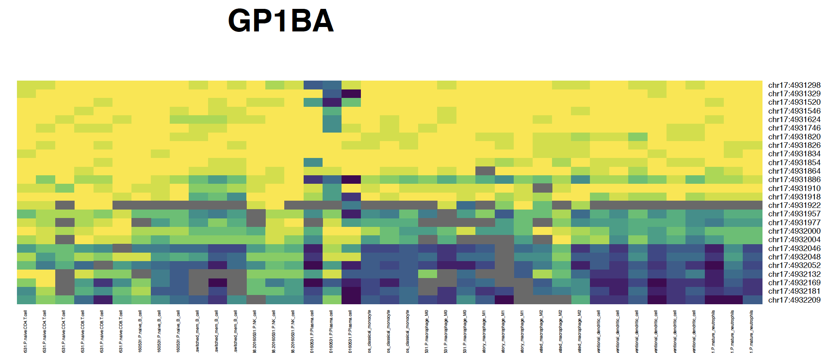
CD42b (GP1BA) promoter
CD4
CD8
nB
cB
NK
PC
Mn
M0
M1
M2
iDC
mDC
mNeu

Slide 6
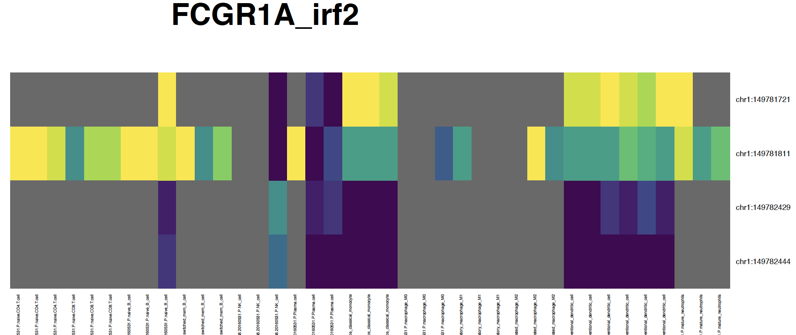
CD64 (FCGR1A) promoter
CD4
CD8
nB
cB
NK
PC
Mn
M0
M1
M2
iDC
mDC
mNeu

Slide 7
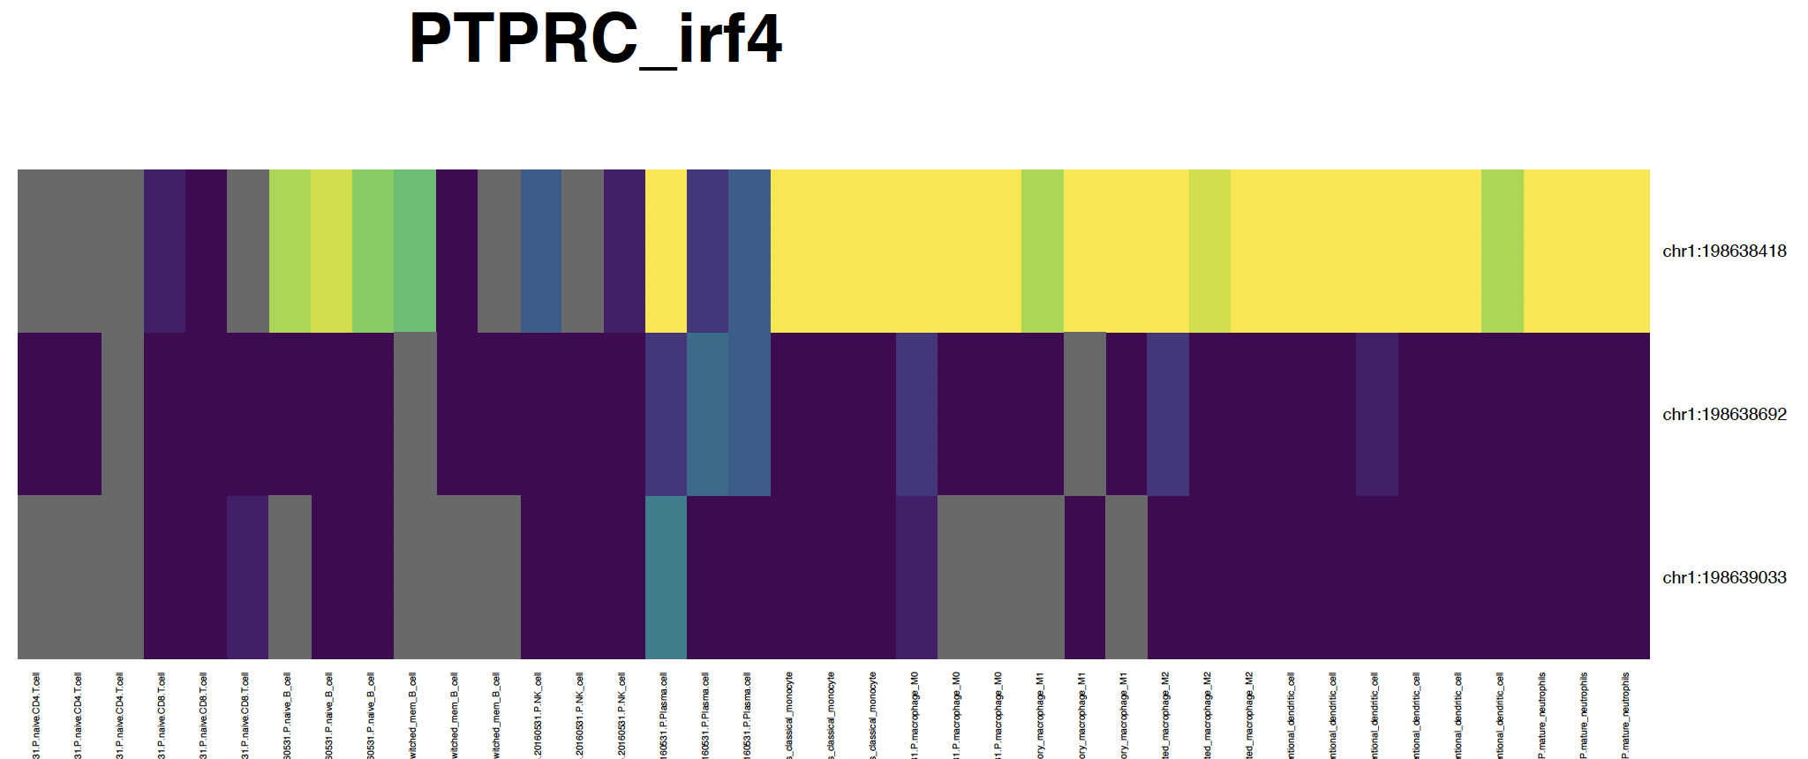
CD45 (PTPRC) promoter
CD4
CD8
nB
cB
NK
PC
Mn
M0
M1
M2
iDC
mDC
mNeu

Slide 8
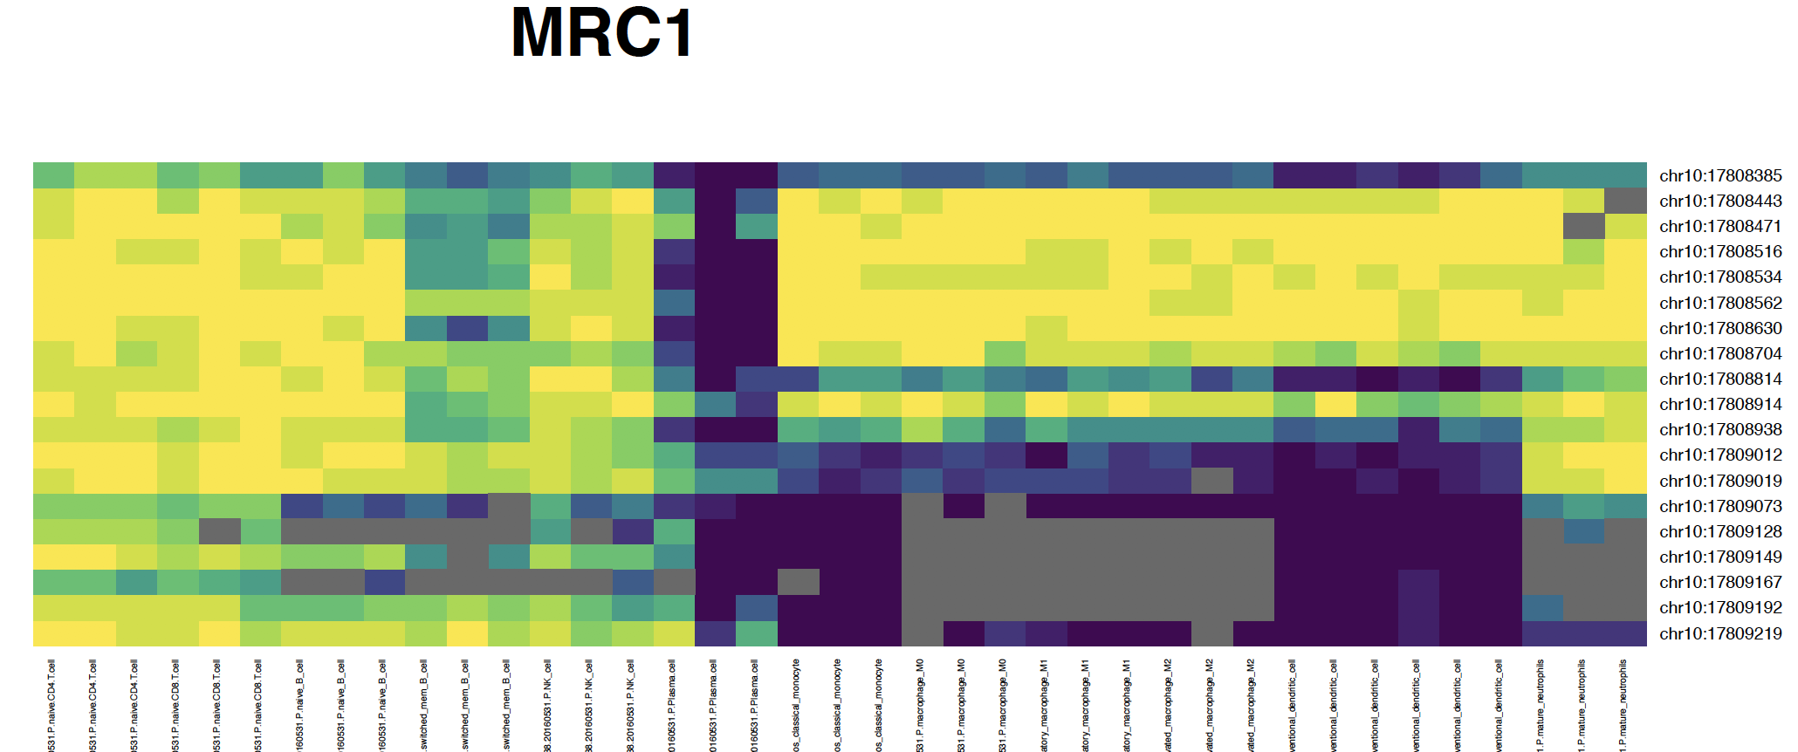
CD206 (MRC1) promoter
CD4
CD8
nB
cB
NK
PC
Mn
M0
M1
M2
iDC
mDC
mNeu

Slide 9
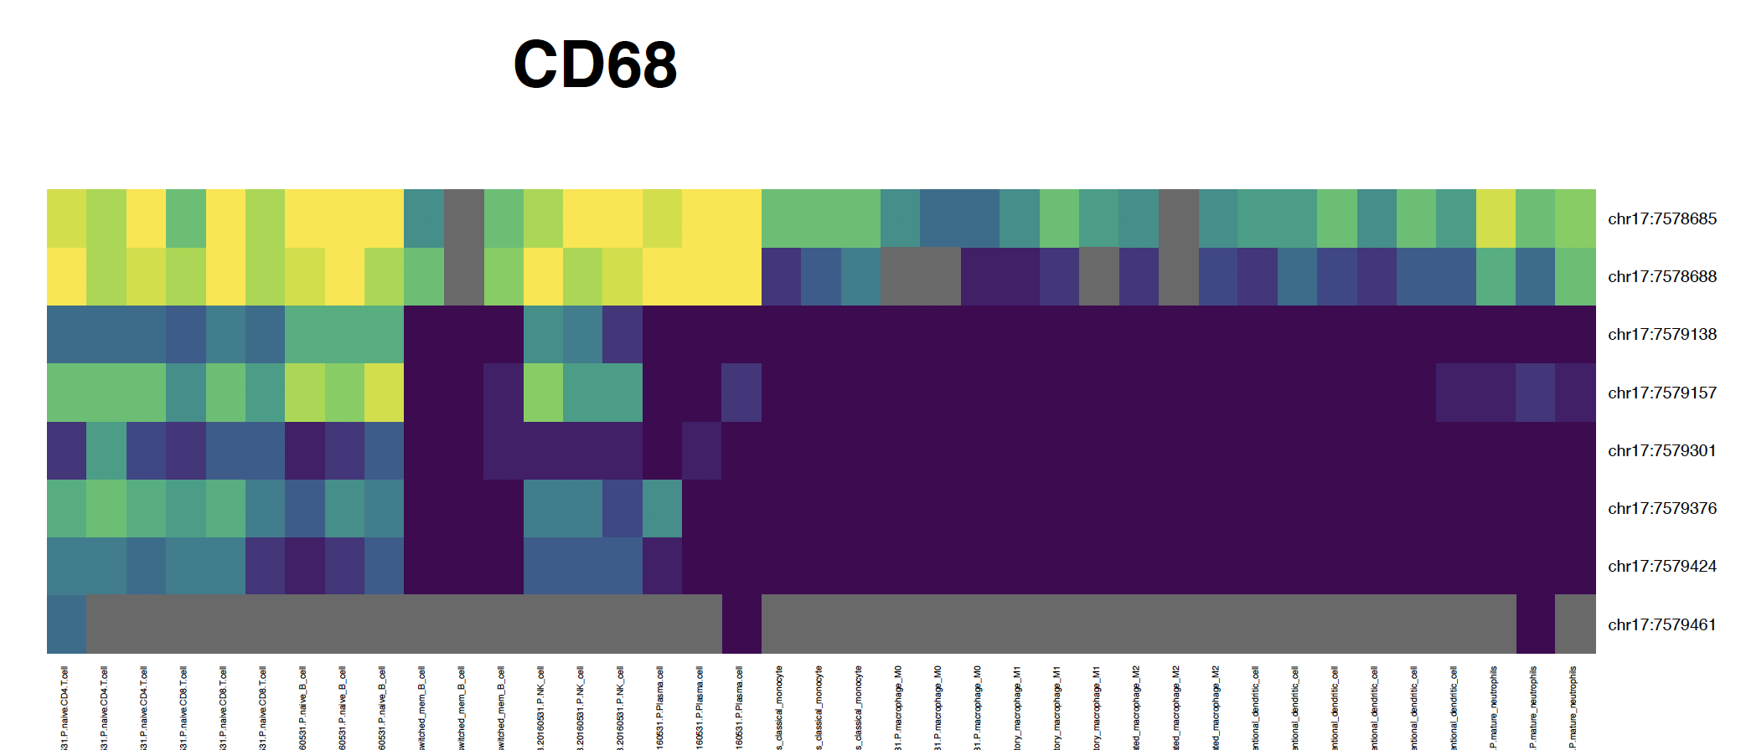
CD68
promoter
CD4
CD8
nB
cB
NK
PC
Mn
M0
M1
M2
iDC
mDC
mNeu

Slide 10
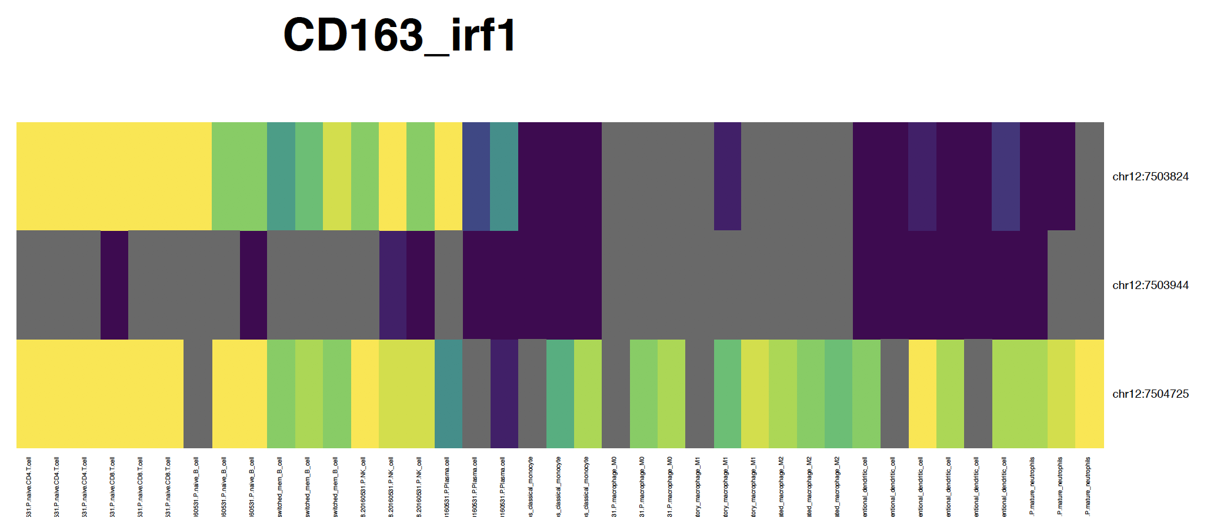
CD163
promoter
CD4
CD8
nB
cB
NK
PC
Mn
M0
M1
M2
iDC
mDC
mNeu

Slide 11
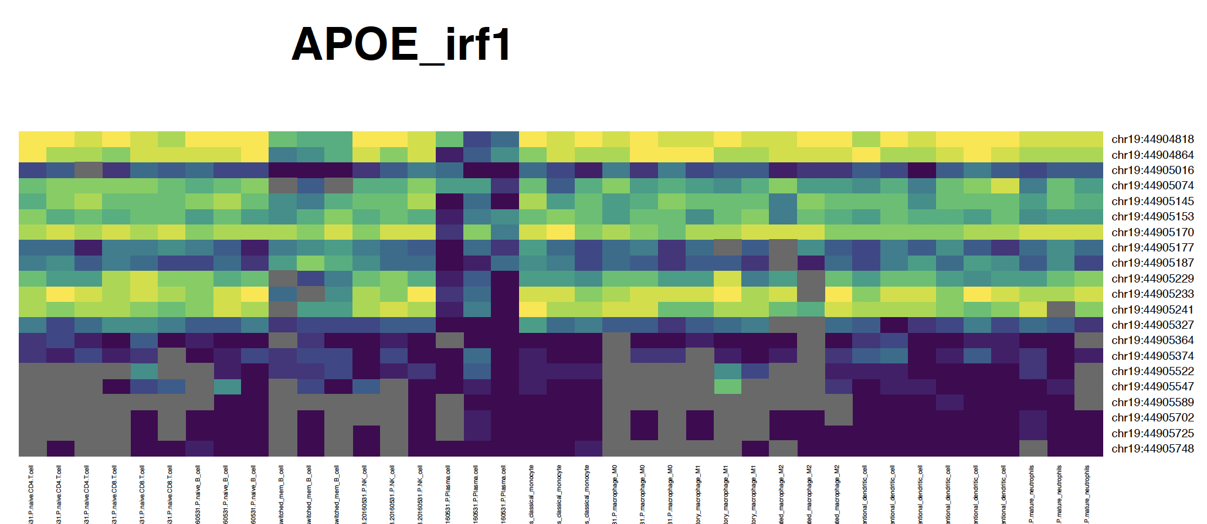
APOE
promoter
CD4
CD8
nB
cB
NK
PC
Mn
M0
M1
M2
iDC
mDC
mNeu

Slide 12
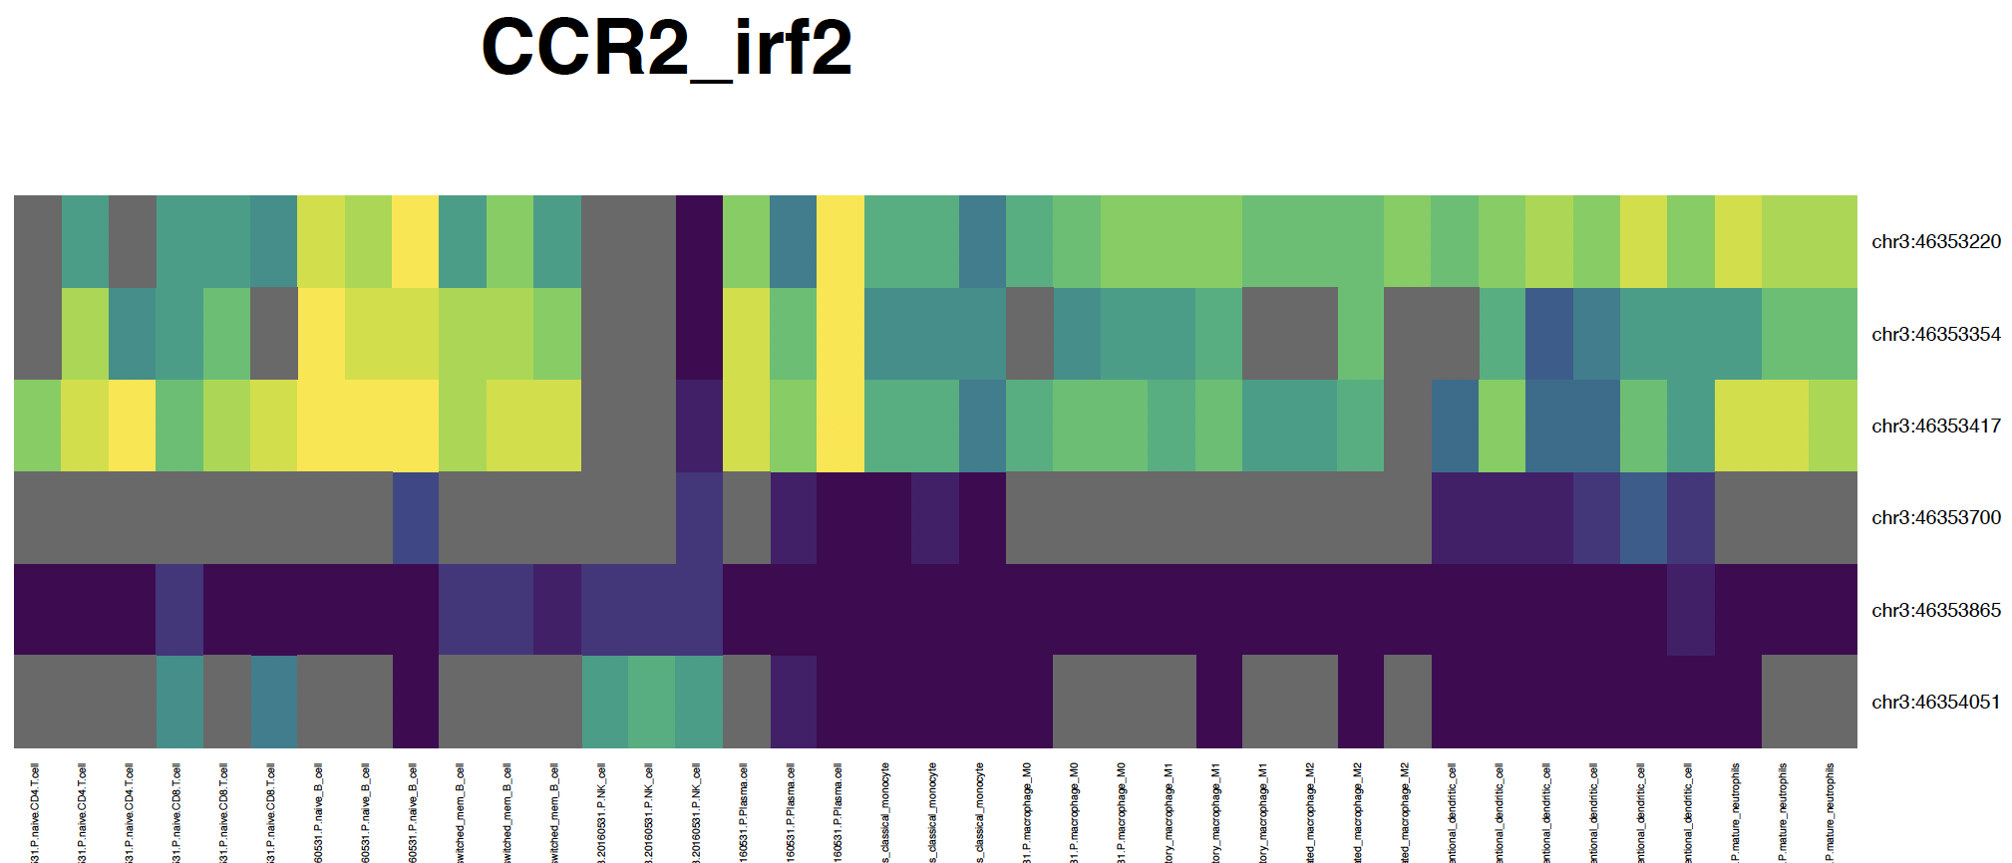
CCR2
promoter
CD4
CD8
nB
cB
NK
PC
Mn
M0
M1
M2
iDC
mDC
mNeu

Slide 13
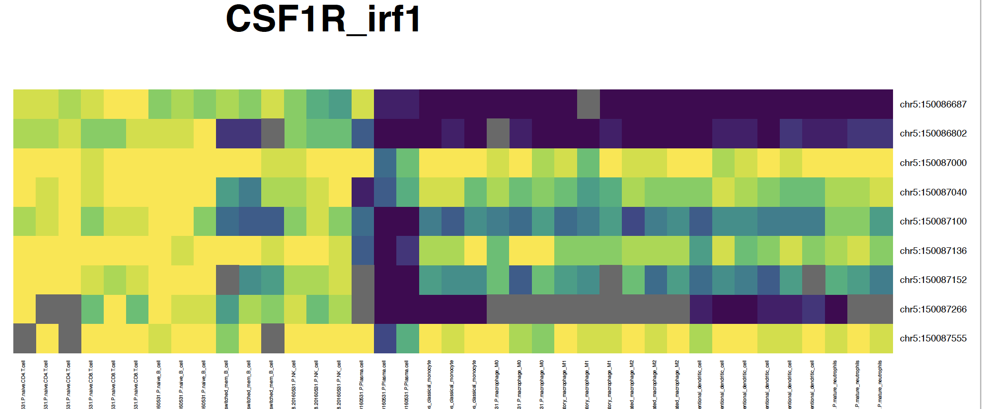
CSF1R
promoter
CD4
CD8
nB
cB
NK
PC
Mn
M0
M1
M2
iDC
mDC
mNeu

Slide 14
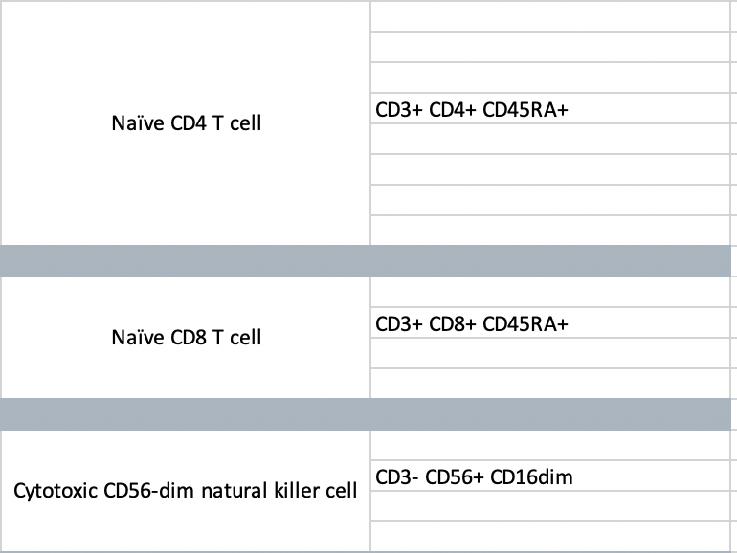
T and NK cell

Slide 15
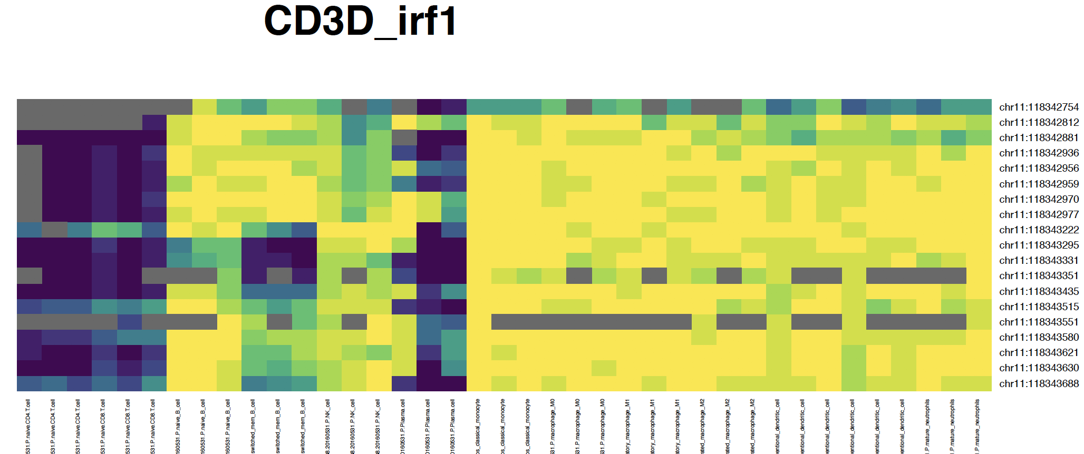
CD3D promoter
CD4
CD8
nB
cB
NK
PC
Mn
M0
M1
M2
iDC
mDC
mNeu

Slide 16
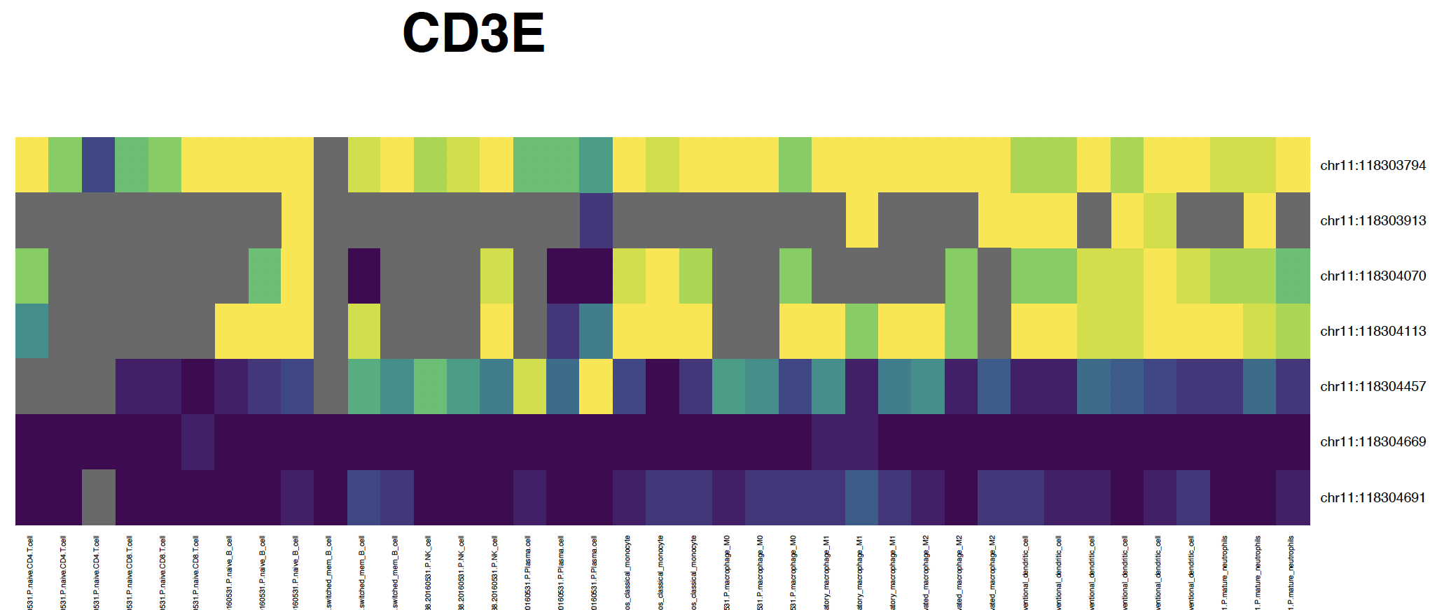
CD3E promoter
CD4
CD8
nB
cB
NK
PC
Mn
M0
M1
M2
iDC
mDC
mNeu

Slide 17
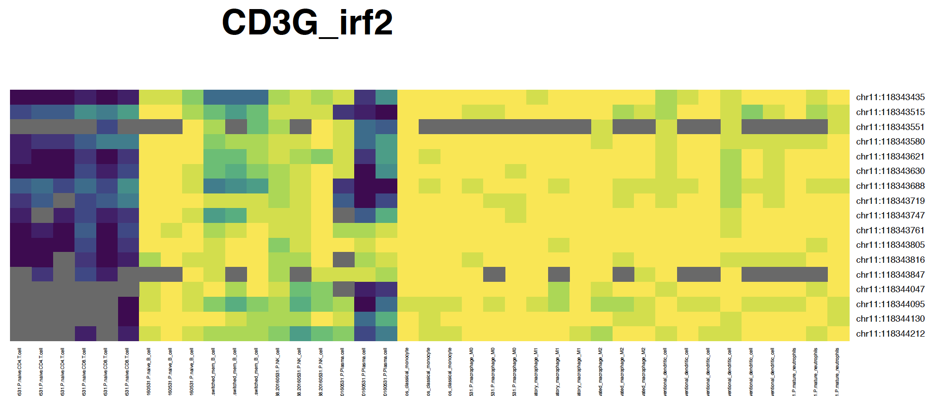
CD3G promoter
CD4
CD8
nB
cB
NK
PC
Mn
M0
M1
M2
iDC
mDC
mNeu

Slide 18
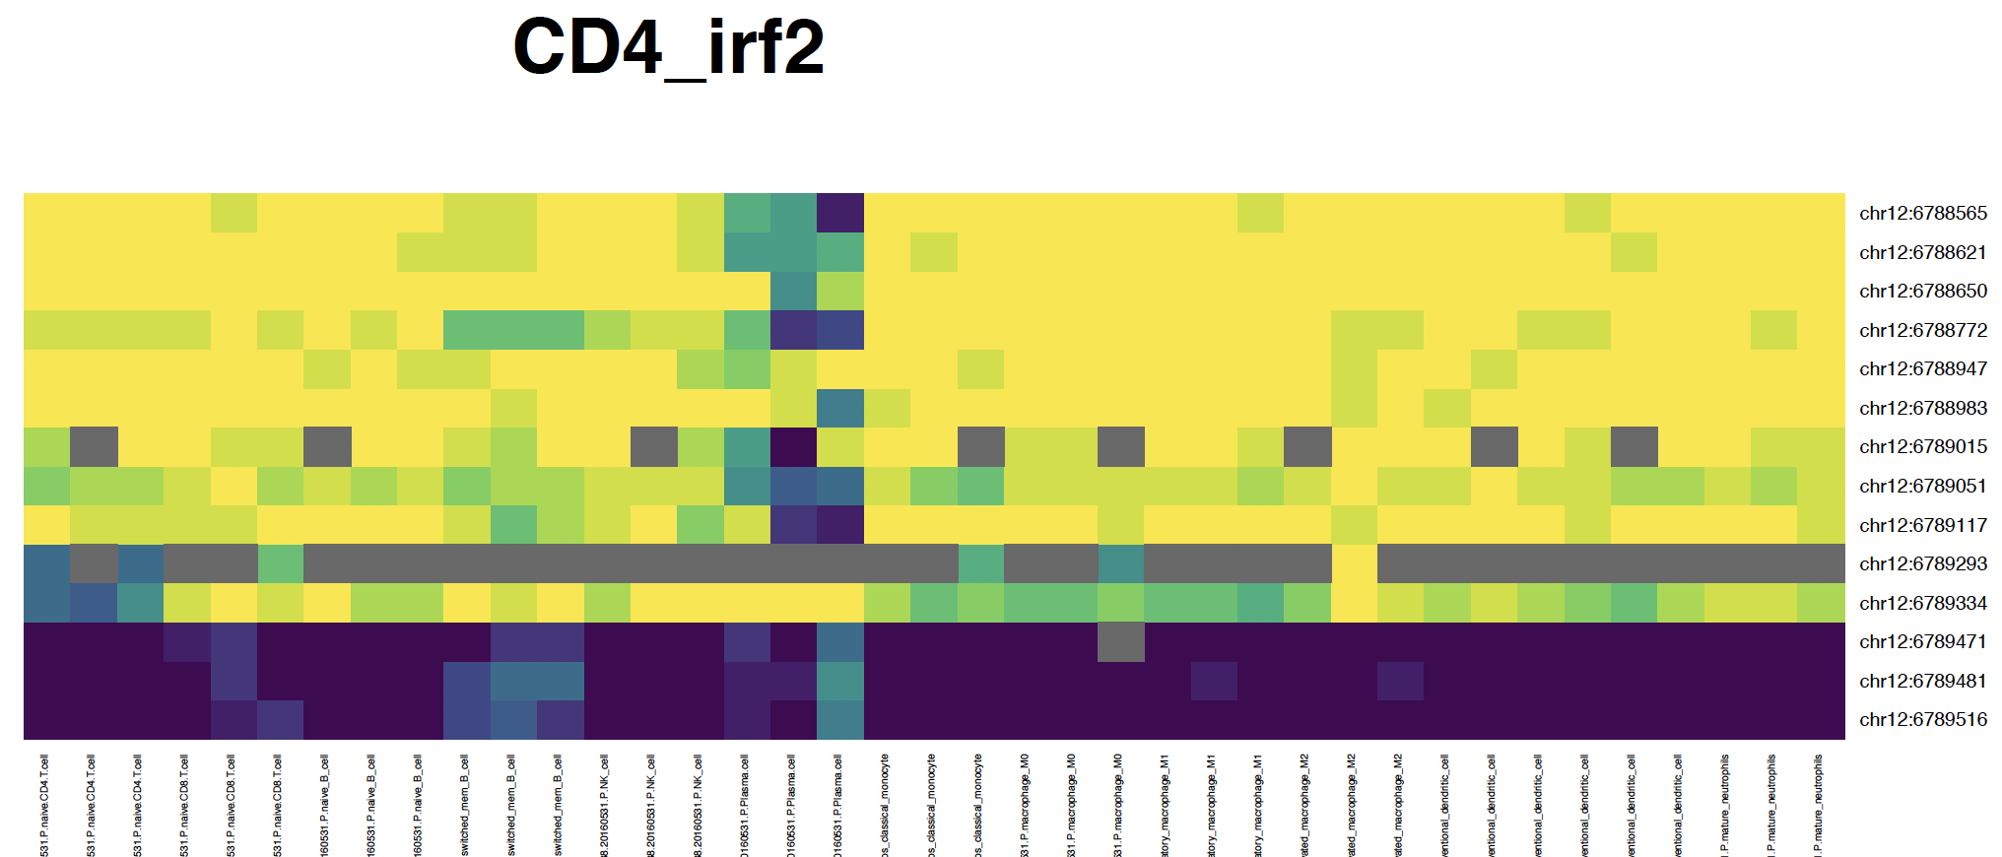
CD4 promoter
CD4
CD8
nB
cB
NK
PC
Mn
M0
M1
M2
iDC
mDC
mNeu

Slide 19
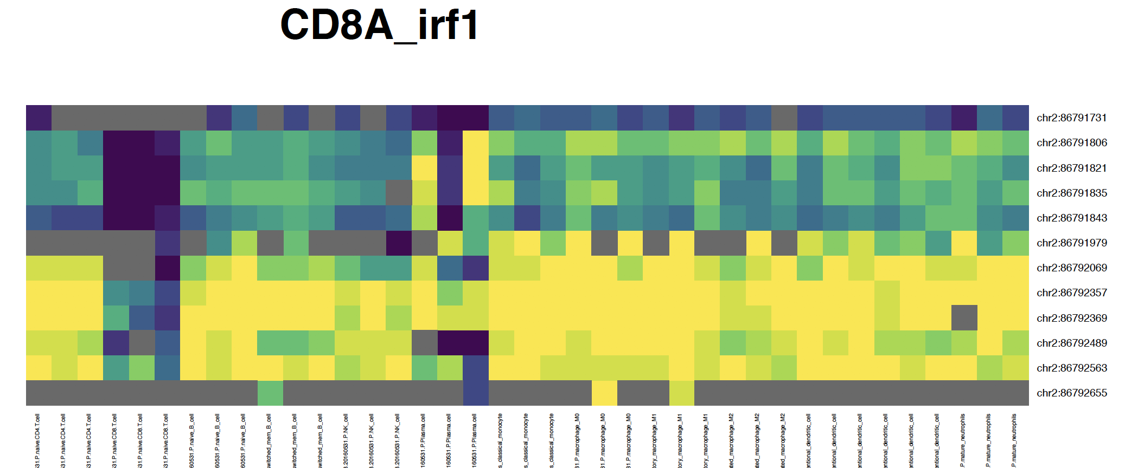
CD8A promoter
CD4
CD8
nB
cB
NK
PC
Mn
M0
M1
M2
iDC
mDC
mNeu

Slide 20
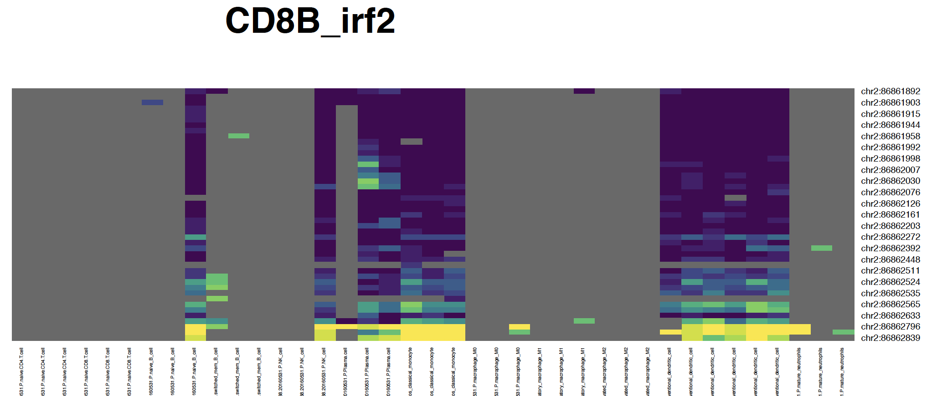
CD8B promoter
CD4
CD8
nB
cB
NK
PC
Mn
M0
M1
M2
iDC
mDC
mNeu

Slide 21
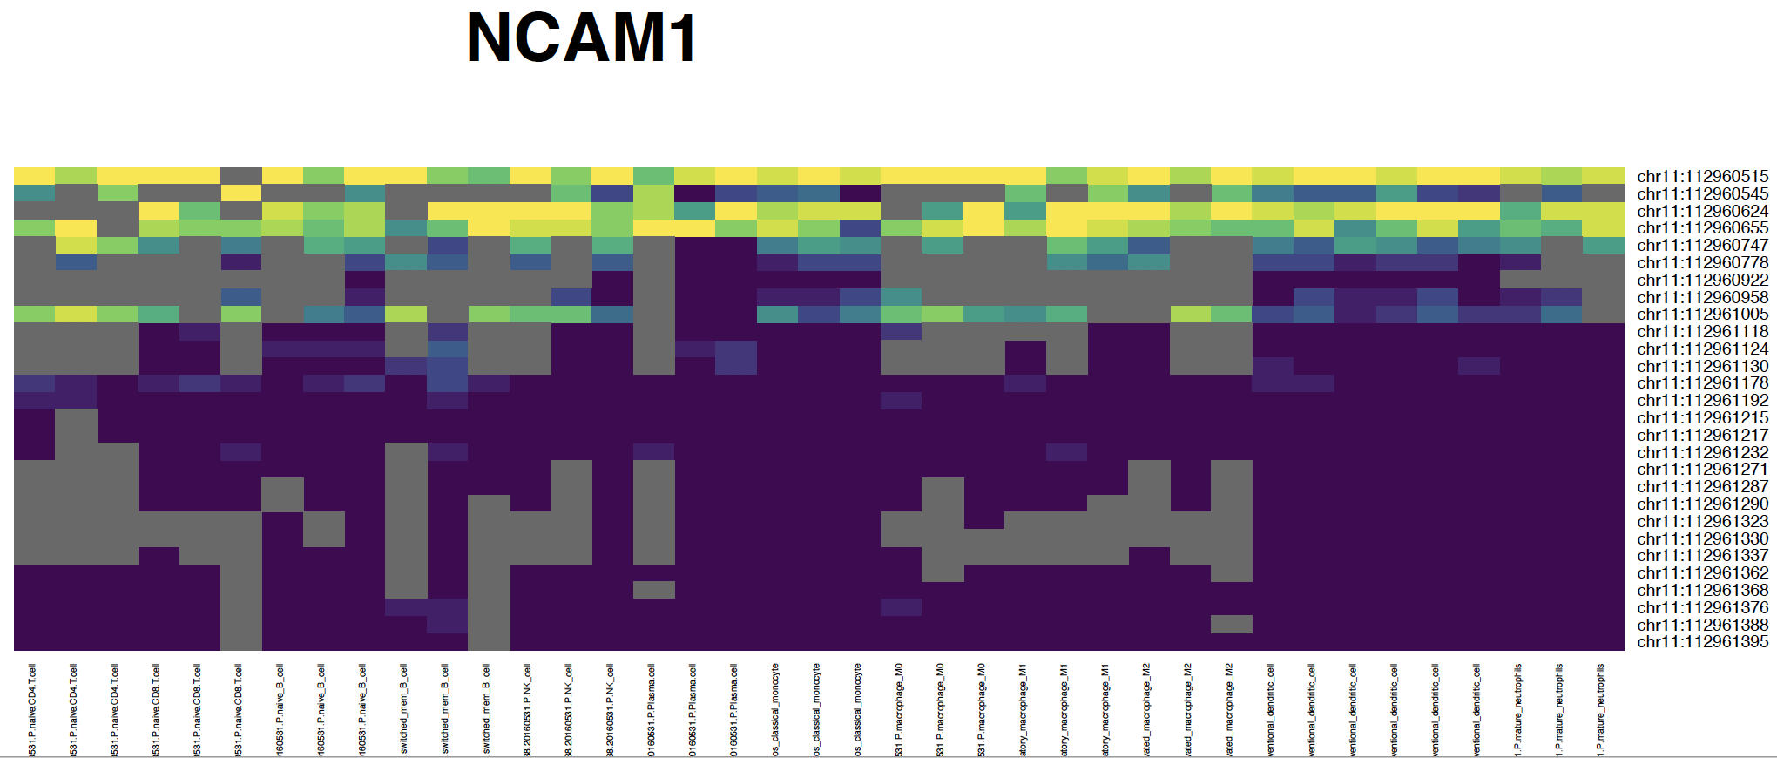
CD56 (NCAM1) promoter
CD4
CD8
nB
cB
NK
PC
Mn
M0
M1
M2
iDC
mDC
mNeu

Slide 22
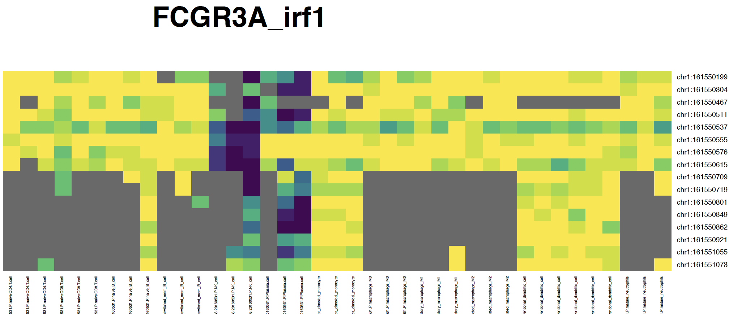
CD16 (FCGR3A) promoter
CD4
CD8
nB
cB
NK
PC
Mn
M0
M1
M2
iDC
mDC
mNeu

Slide 23
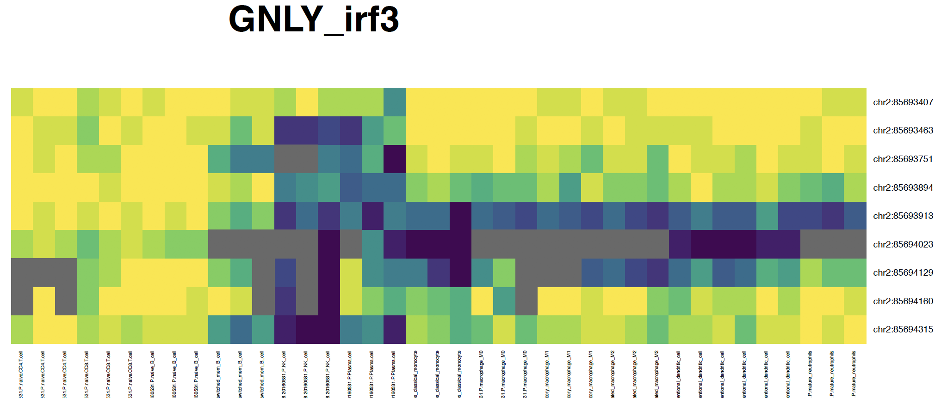
GNLY
promoter
CD4
CD8
nB
cB
NK
PC
Mn
M0
M1
M2
iDC
mDC
mNeu

Slide 24
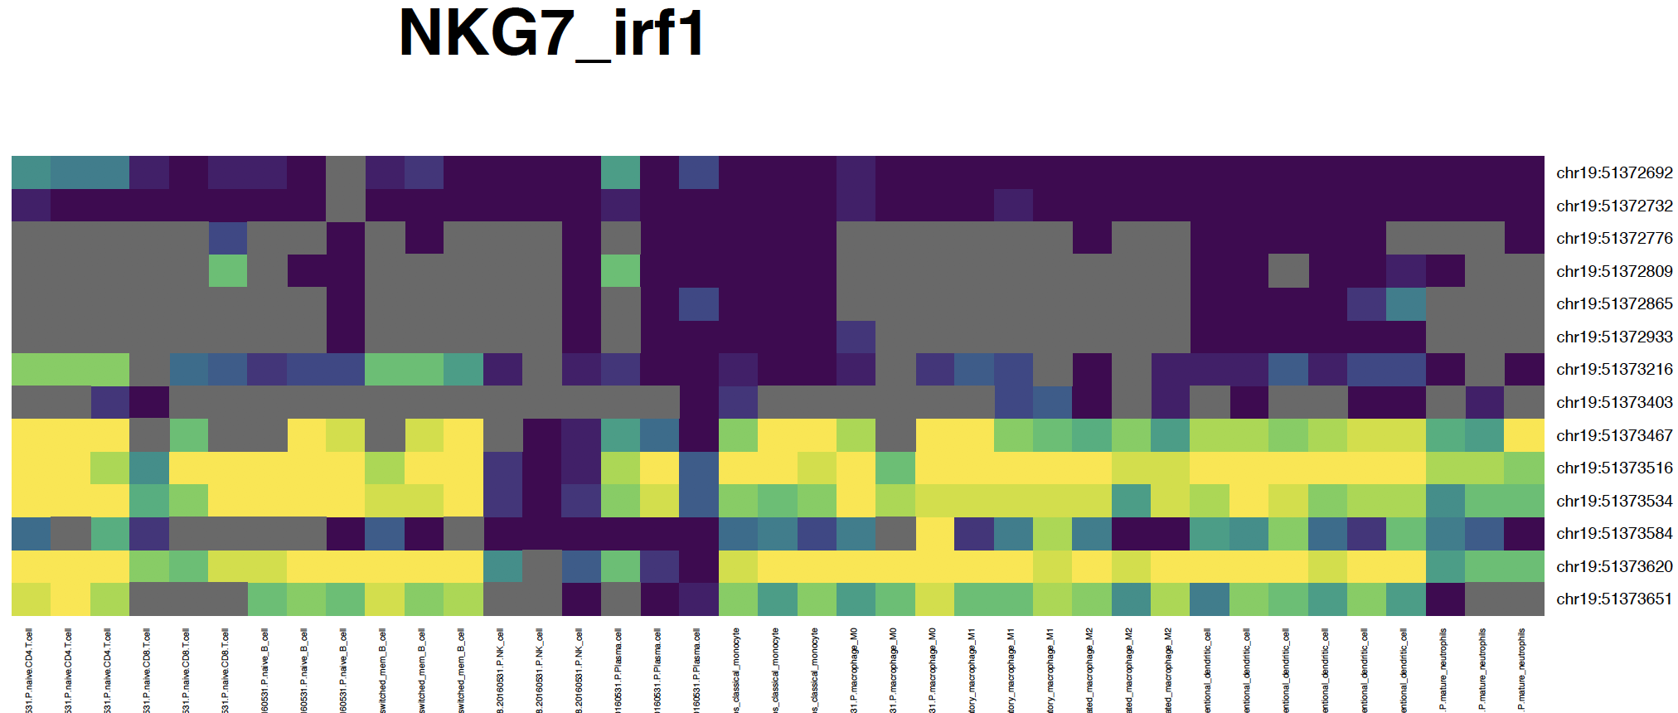
NKG7
promoter
CD4
CD8
nB
cB
NK
PC
Mn
M0
M1
M2
iDC
mDC
mNeu

Slide 25
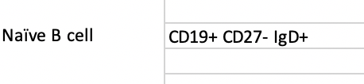

B and Plasma cell

Slide 26
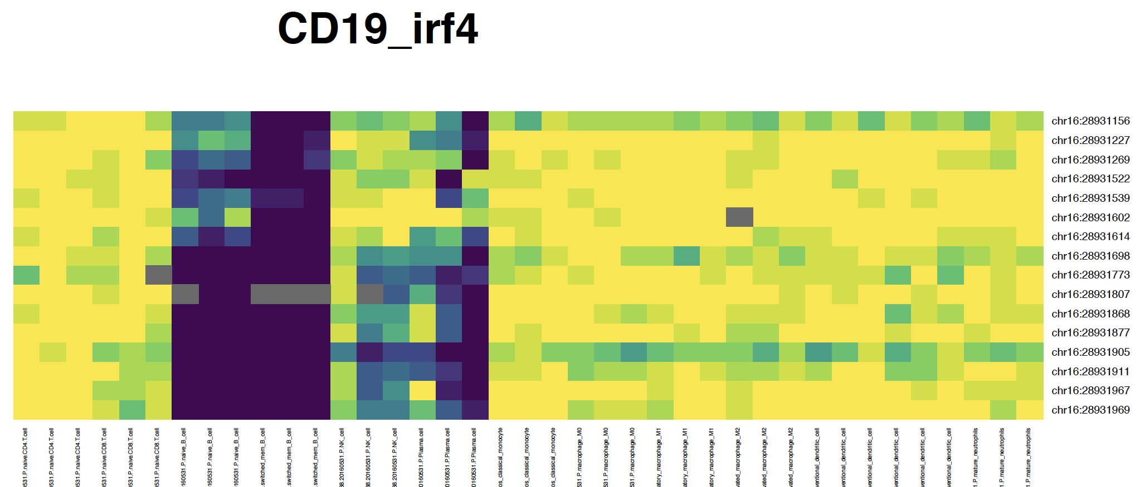
CD19 promoter
CD4
CD8
nB
cB
NK
PC
Mn
M0
M1
M2
iDC
mDC
mNeu

Slide 27
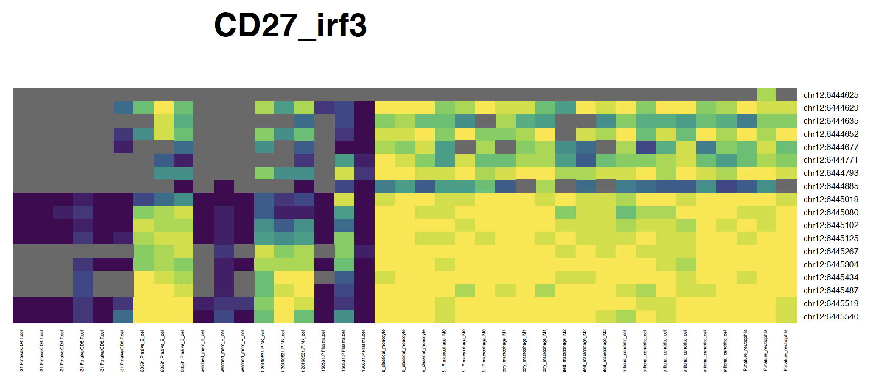
CD27 promoter
CD4
CD8
nB
cB
NK
PC
Mn
M0
M1
M2
iDC
mDC
mNeu

Slide 28
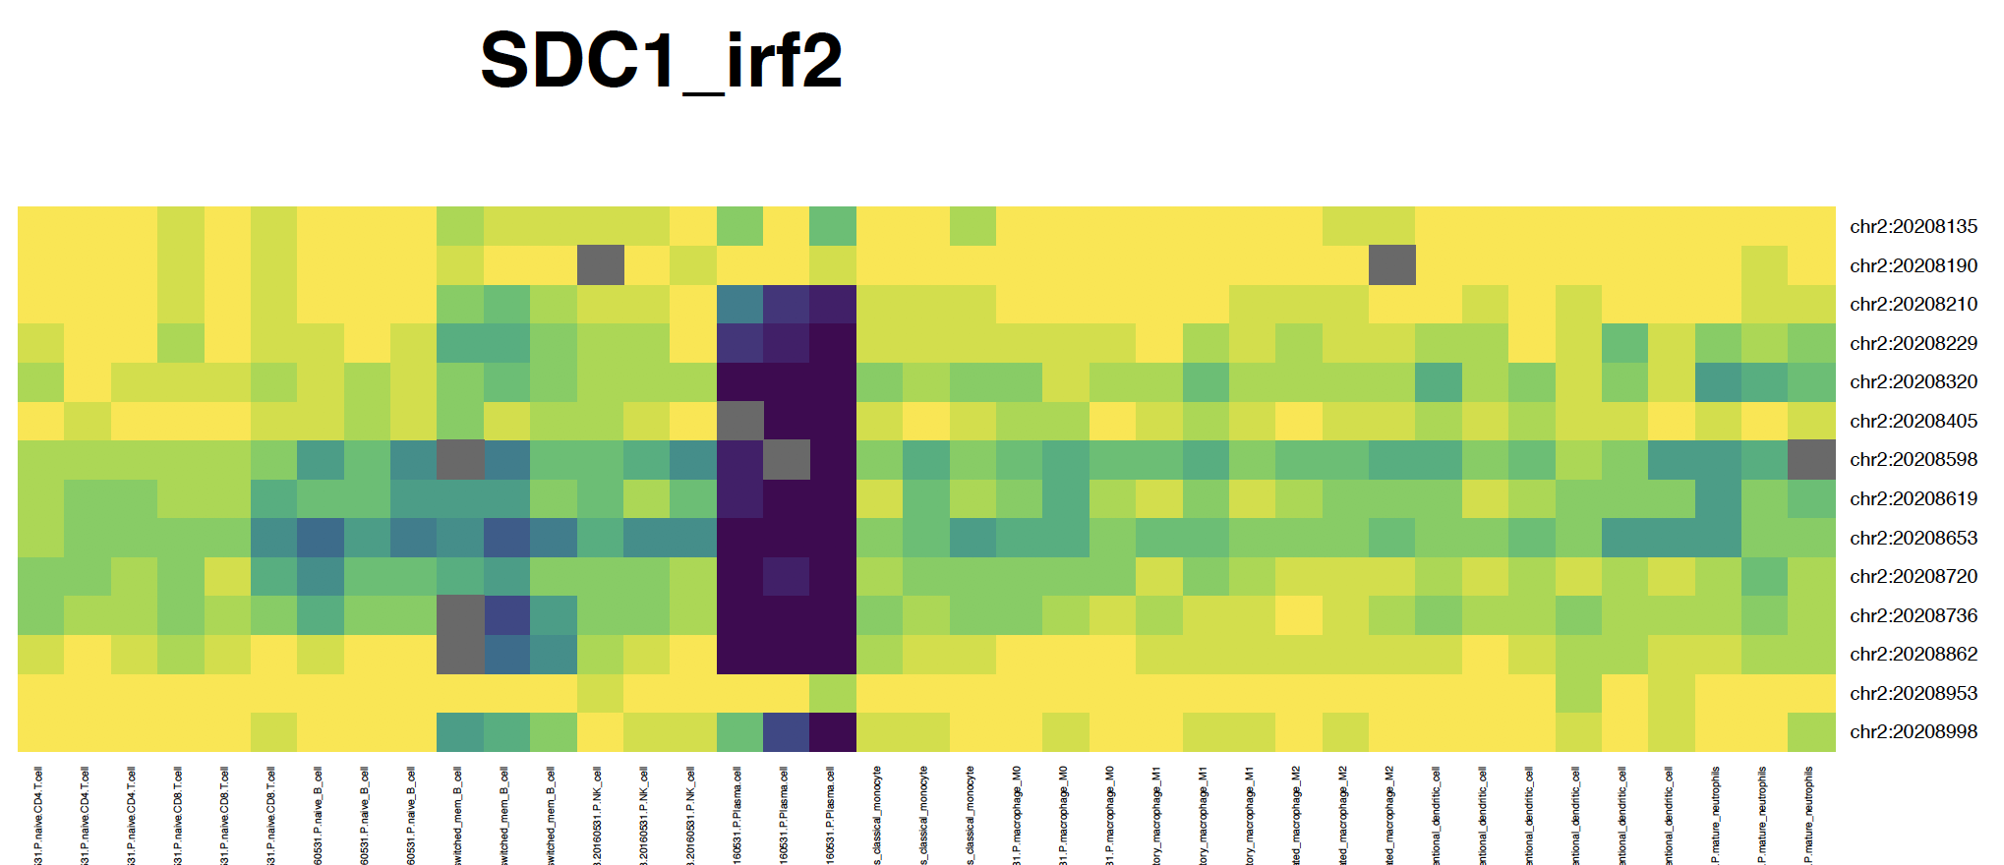
CD138 (SDC1) promoter
CD4
CD8
nB
cB
NK
PC
Mn
M0
M1
M2
iDC
mDC
mNeu

Slide 29
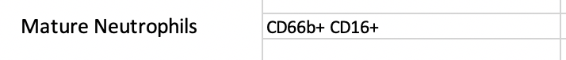
mNeu

Slide 30
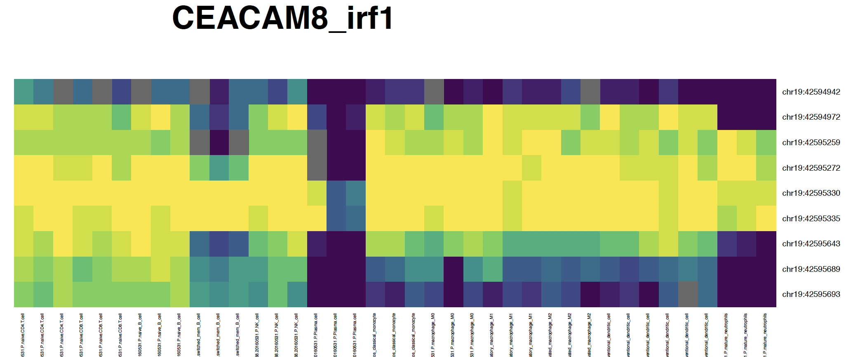
CD66b (CEACAM8) promoter
CD4
CD8
nB
cB
NK
PC
Mn
M0
M1
M2
iDC
mDC
mNeu

Slide 31
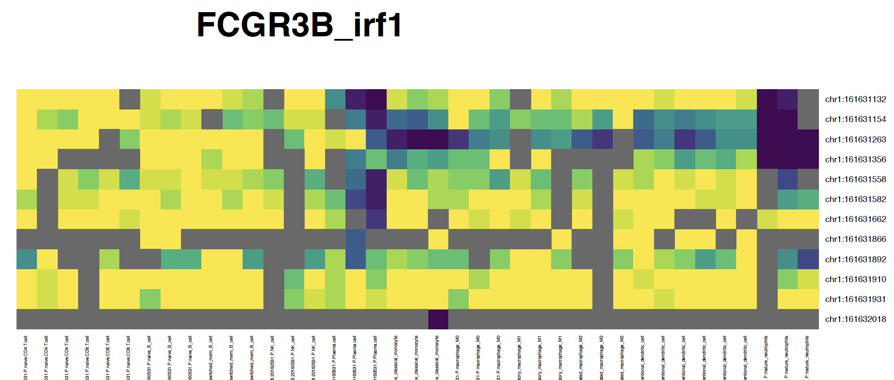
CD16 (FCGR3B) promoter
CD4
CD8
nB
cB
NK
PC
Mn
M0
M1
M2
iDC
mDC
mNeu

Slide 32
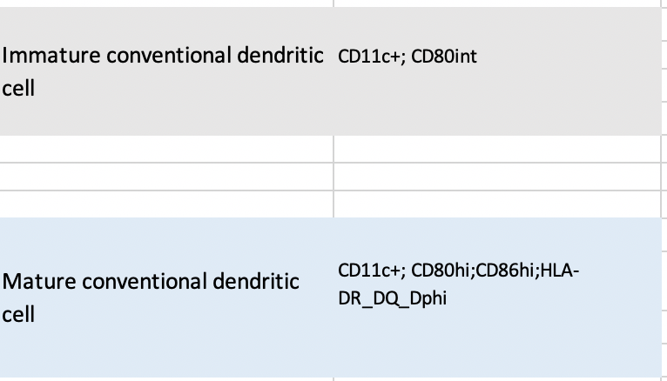
iDC,mDC

Slide 33
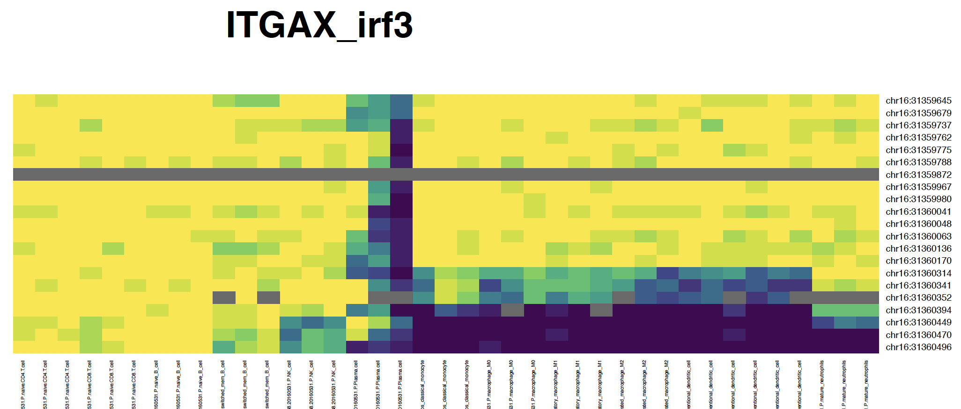
CD11c (ITGAX) promoter
CD4
CD8
nB
cB
NK
PC
Mn
M0
M1
M2
iDC
mDC
mNeu

Slide 34
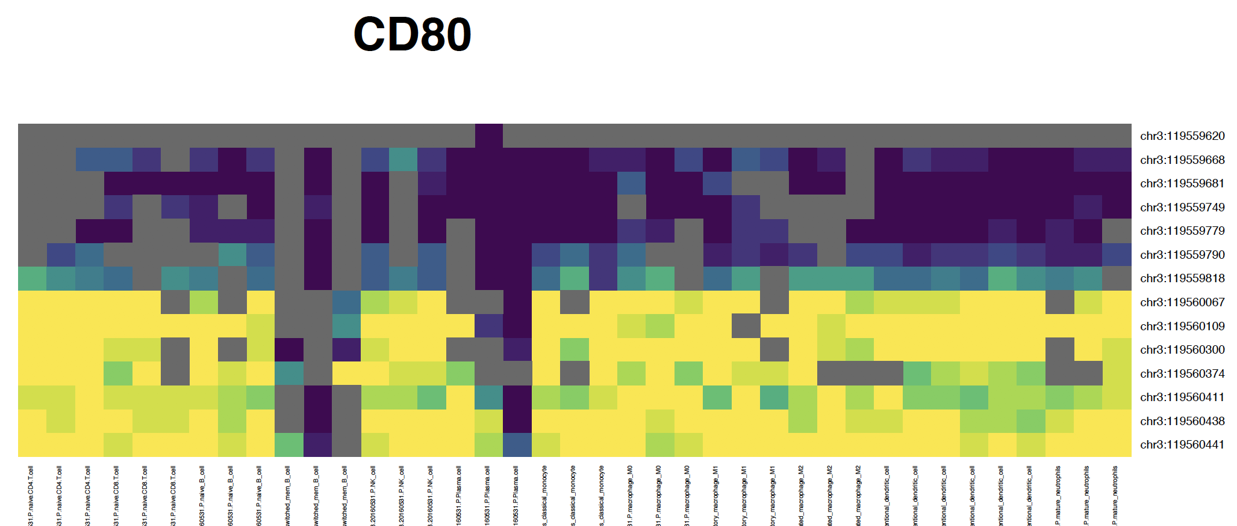
CD80 promoter
CD4
CD8
nB
cB
NK
PC
Mn
M0
M1
M2
iDC
mDC
mNeu

Slide 35
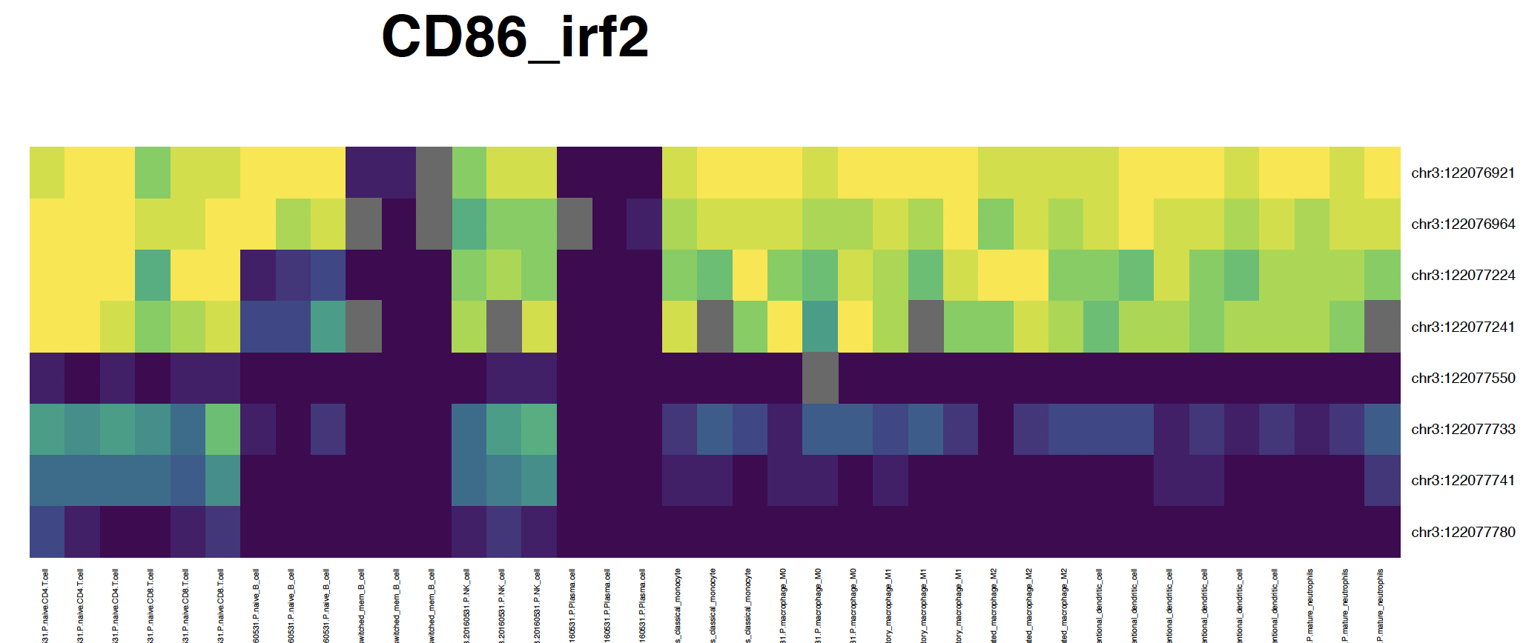
CD86 promoter
CD4
CD8
nB
cB
NK
PC
Mn
M0
M1
M2
iDC
mDC
mNeu

Slide 36
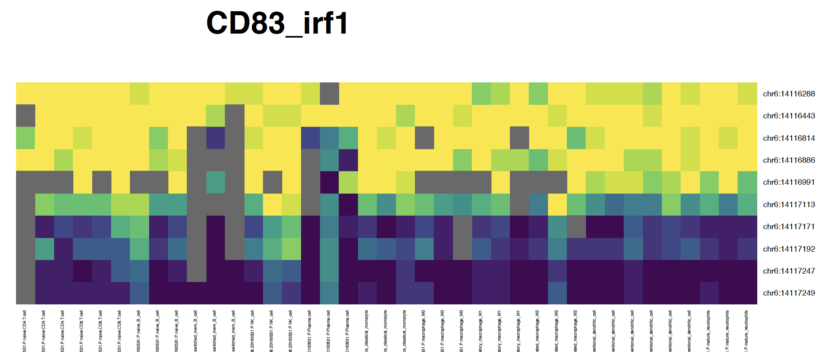
CD83 promoter
CD4
CD8
nB
cB
NK
PC
Mn
M0
M1
M2
iDC
mDC
mNeu

Slide 37
DMR in marker regions

Slide 38
Overview
We have found DMRs while we developed the 13 cell types reference.
From Blueprint marker list, we tested if our cell type specific DMR intersects with those marker genes and their promoter (1 kb upstream)
Tested Marker genes:
['CD3D','CD3E','CD3G','CD4','CD8A','CD8B','CD19','CD27','CD14','FCGR3A','FCGR3B','GP1BA’,
'FCGR1A','FCGR1B','FCGR1CP','PTPRC','CEACAM8','NCAM1','SDC1','ITGAX','CD80','CD86']

Slide 39
DMRs in marker gene body and promoter
CD4 T
CD4
CD8 T
CD8A
CD8B
nB
CD19
cB
CD19
CEACAM8
CD80
CD86
NK
FCGR3A
PTPRC
ITGAX
mNeu
CEACAM8
PC
SDC1
CEACAM8
ITGAX
CD4
CD14
CD19
CD8B
CD8A
CD3G
CD3D
CD3E
NCAM1
CD80
CD86
Mn, M0, M1, M2, iDC and mDC DMRs have no overlapping in the tested regions
Notes:
nB te CD19 but hyper as cB is there

Slide 40
Summary
Probably we want to remove macrophages and combine iDC and mDC

Slide 41
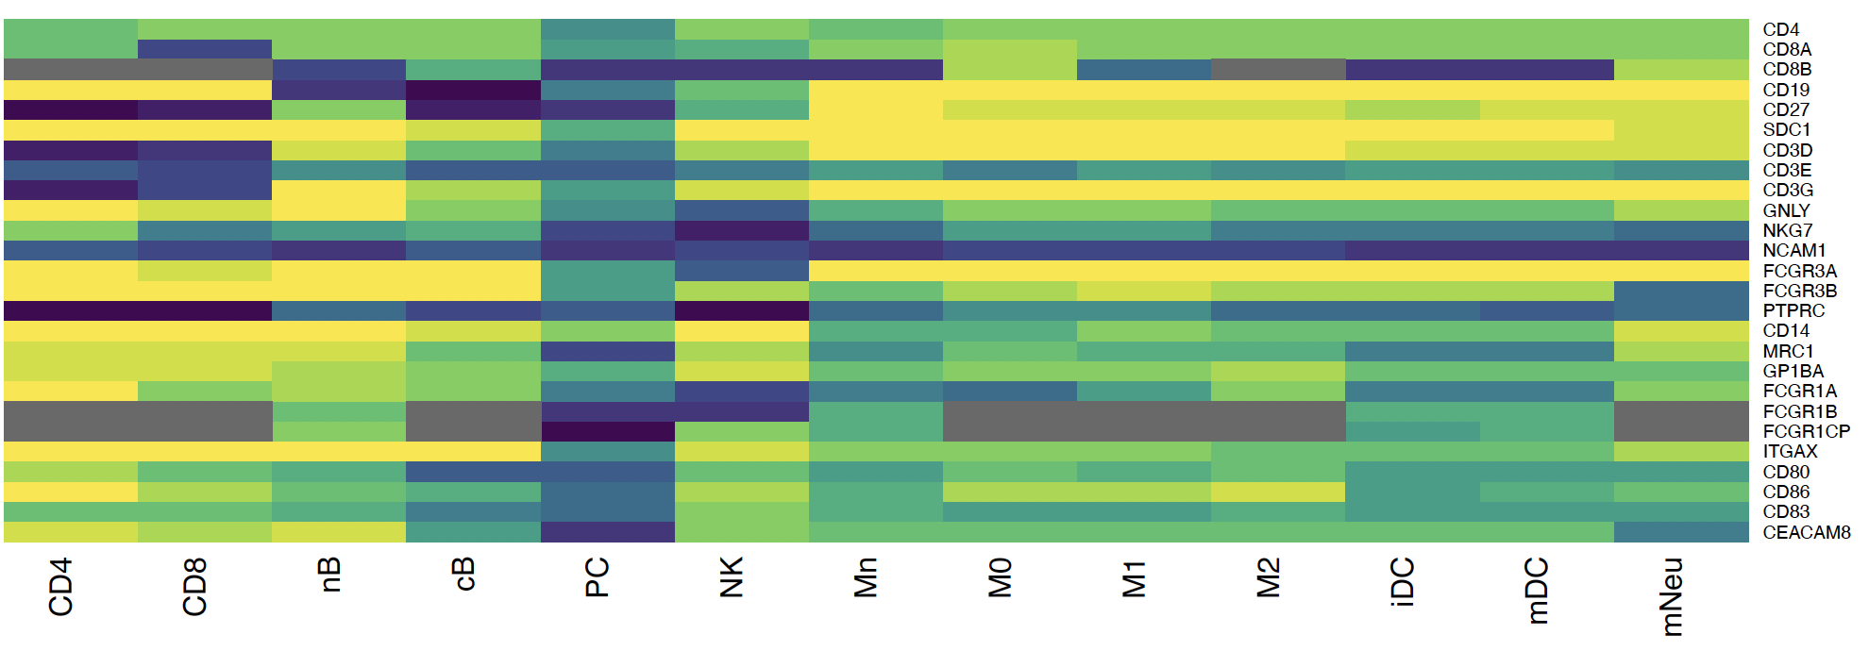
Summary

Slide 42
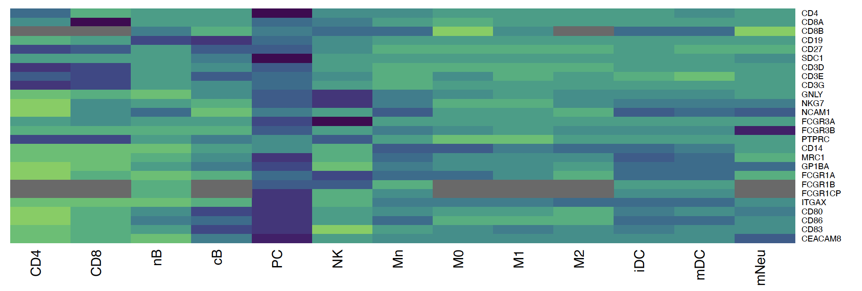
Summary (z-score)

